Slide 1

How far did we get in face spoofing detection?
Sohaib Reza
Md. Iftekhar Hossain
Md. Nur Alam

Slide 2
What we will discuss?
What is face spoofing?
Different spoofing attacks
Detection techniques
Performance analysis of existing approaches

Slide 3
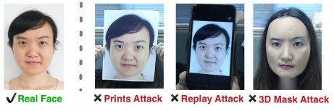
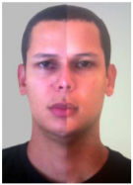
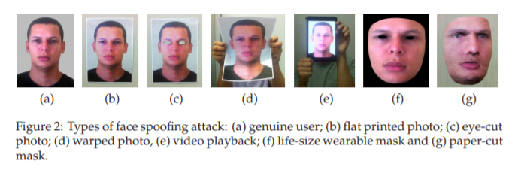
What is face spoofing?
What is face spoofing detection?
Face spoofing detection/liveness detection is to identify an impostor trying him/herself as a genuine user in facial recognition systems.
Different Face spoofing attacks
Flat printed photo
Eye-cut photo attack
Warped photo
Video playback
Mask

Slide 4
Face spoofing detection approaches
Spoofing attacks can be verified by different approaches. We organized all gathered works in terms of Descriptors and Classifiers.
Descriptors were categorized as texture, motion, frequency, color, shape or reflectance.
Classifiers are organized as discriminant, regression, distance metric or heuristic.
Descriptors | Related works
Texture | LBP and variations, Gabor Wavelets, GLCM, LGS, ILGS, LPQ, DoG, HOG, HSC, DNN, Texture, MLPQ-TOP, MBSIF-TOP
Motion | HOOF, OFL, Motion Correlation, GMM, DMD, CRF, RASL, HMOF, Motion
Frequency | 2D-DFT, 1D-FFT, 2D-FFT, Haar Wavelets
Color | CF, IDA, IQA, IQM, Color
Shape | CLM
Reflectance | Variational Retinex
Classifiers | Related works
Discriminant | SVM, Adaboost, LDA, MLP, NN, CNN, BN
Regression | LLR, LR, SLR, SLRBLR, PLS, KDA
Distance Metric | χ 2, Cosine
Heuristic | Thresholding, Weighted sum, Blink count
Summary of Classifiers and their related works
Summary of Descriptors and their related works

Slide 5
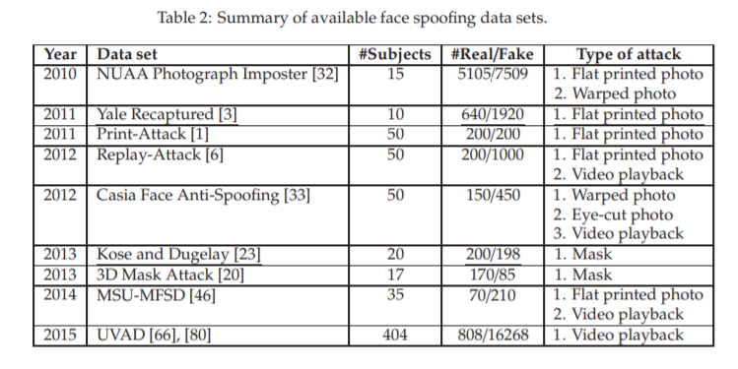
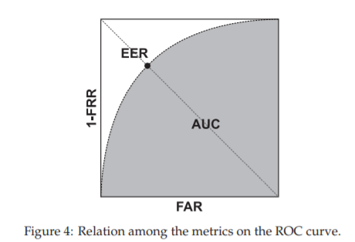
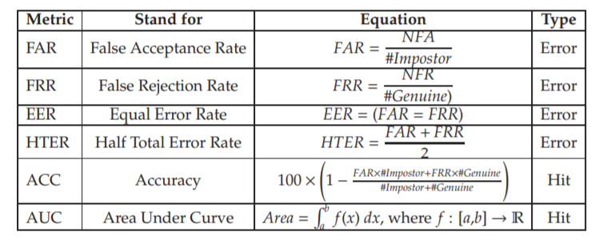
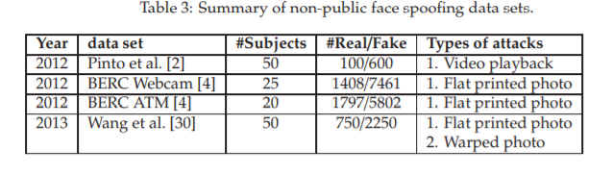
Datasets
Performance Metrics

Slide 6
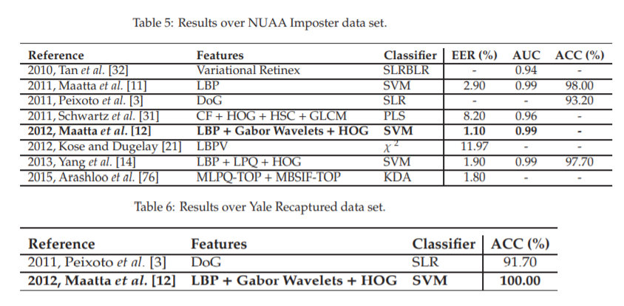
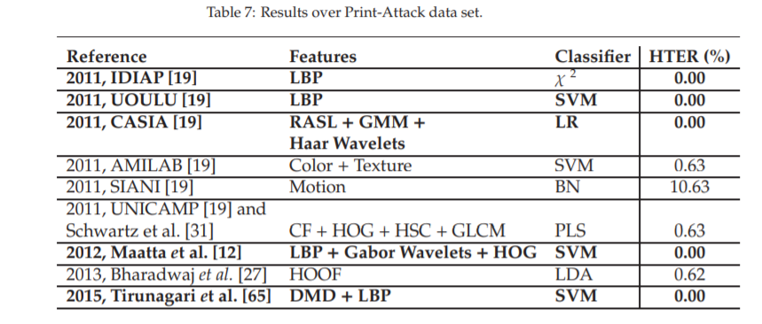
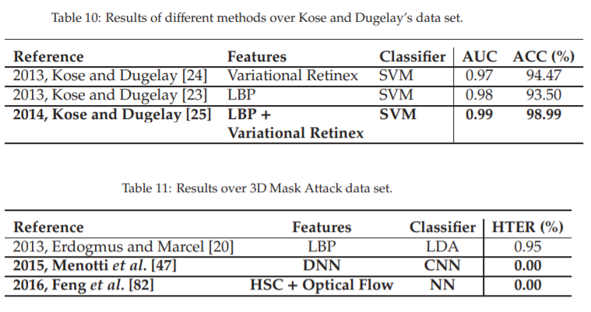
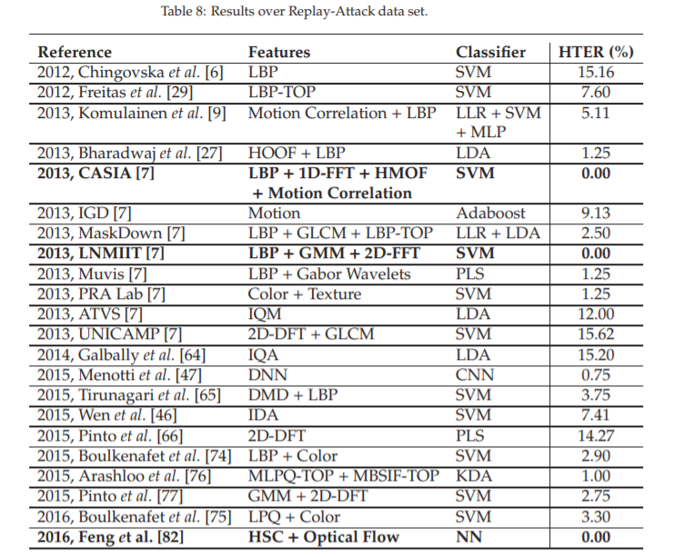
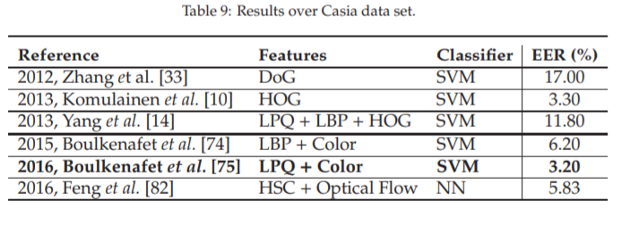
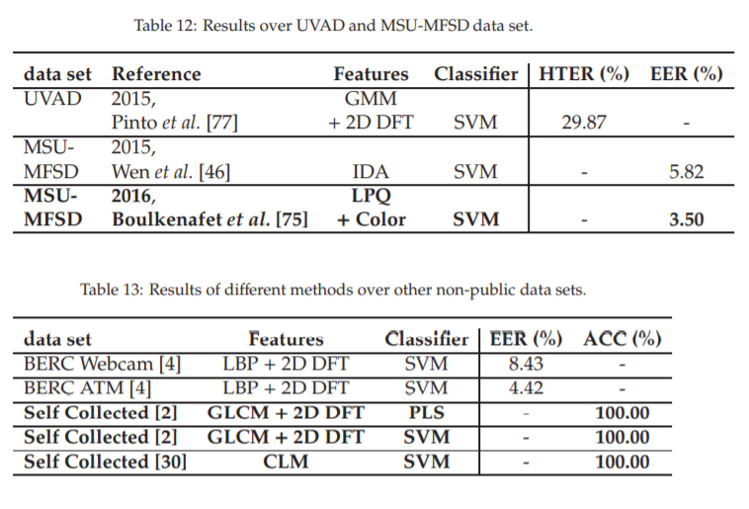
Quantitative comparison of existing spoofing detectors

Slide 7
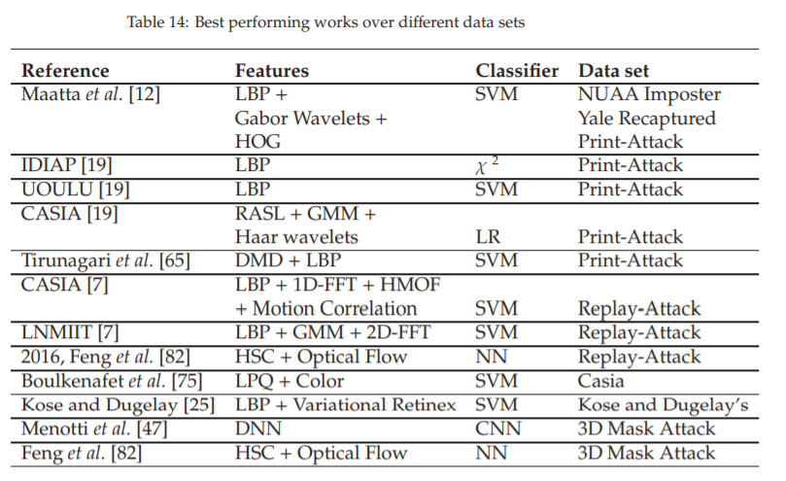
Best performing works over different data sets

Slide 8
Discussion
Automatic detection of imposters
Most of the time, spoofing detection follows face recognition trends.
All surveyed works perform training and testing using the same data set.
Open Issues
A lack of a standard evaluation protocol for spoofing detection methods
Future Directions
Performance rapidly degrade for texture-based solutions. Motion Correlation, seems to be a more promising way of achieving Eye-cut photo attack
Transfer learning have not been exploited so far Video playback
Multimodal biometric system

Slide 9
Conclusion
Spoofing attacks persist to be a security challenge for face biometric systems, and there were much effort in the field to find robust methods.

Slide 10
Reference
How far did we get in face spoofing detection?
Luiz Souza, Mauricio Pamplona, Luciano Oliveira
IVISION Lab, Federal University of Bahia
Joao Papa
RECOGNA Lab, Sao Paulo State University

Slide 11
Thanks!
Any questions?
You can find us at
a.m.sohaib.reza@g.bracu.ac.bd
md.iftekhar.hossain.rimon@g.bracu.ac.bd
md.nur.alam@g.bracu.ac.bd

